Slide 1


Slide 2
Examination System
CONTENT
01.
Introduction
02.
ERD & Mapping
Entity Relationship Diagram
An Overview of the Project
04.
DESKTOP APP
03.
SQL & SP
Building an Examination System App
An Overview of the Project
05.
SSRS
06.
Power BI
Creating Reports using SSRS tool in Visual Studio
Using Microsoft Power BI to build Dashboards & Insights

Slide 3
Introduction
- First, we have started suggesting a trade mark that we will start our project with, then we have agreed on one.
- Second, we have created an ERD and mapping it to relational tables model.
third, we created our Database with some DDL and DML functions to fit the project needs.
Fourth, we started working on the desktop application that took much effort to get the perfect performance and perfect design model.
Fifth, we have filled the Database by application so we can make reports on SSRS and dashboards to get insights by Power BI.
Sixth, we have created report by using SSRS and designed it to meet expectations.
lastly, it was the time for creating dashboard by Power Bi to get insights that might help the business needs in the future.

Slide 4




Examination System
Team Members
Mahmoud Abd El-Hakm
Abd El-Malek Anas
Hanan Othman
Mohamed Atef

Slide 5

EXAMINATION SYSTEM PROJECT
Team Member Roles
Mahmoud Abd El-Hakam
Abd El-Malek Anas
Mohamed Atef
Hanan Othman
ERD.
Mapping.
Database.
Data Base.
Stored Procedures.
Examination System App; “Linking between the Data Base and the desktop App, Exception Handling, Testing the code.
SSRS.
Examination System App;
Designing the Desktop App, Running functions and others.
Documentation.
Presentation
Power Bi.
Analyzing Data.
create Dashboards and Get insights.
API Graph of Facebook & Linked in Social Media Websites.

Slide 6

01.
ERD & Mapping
Entity Relationship Diagram

Slide 7
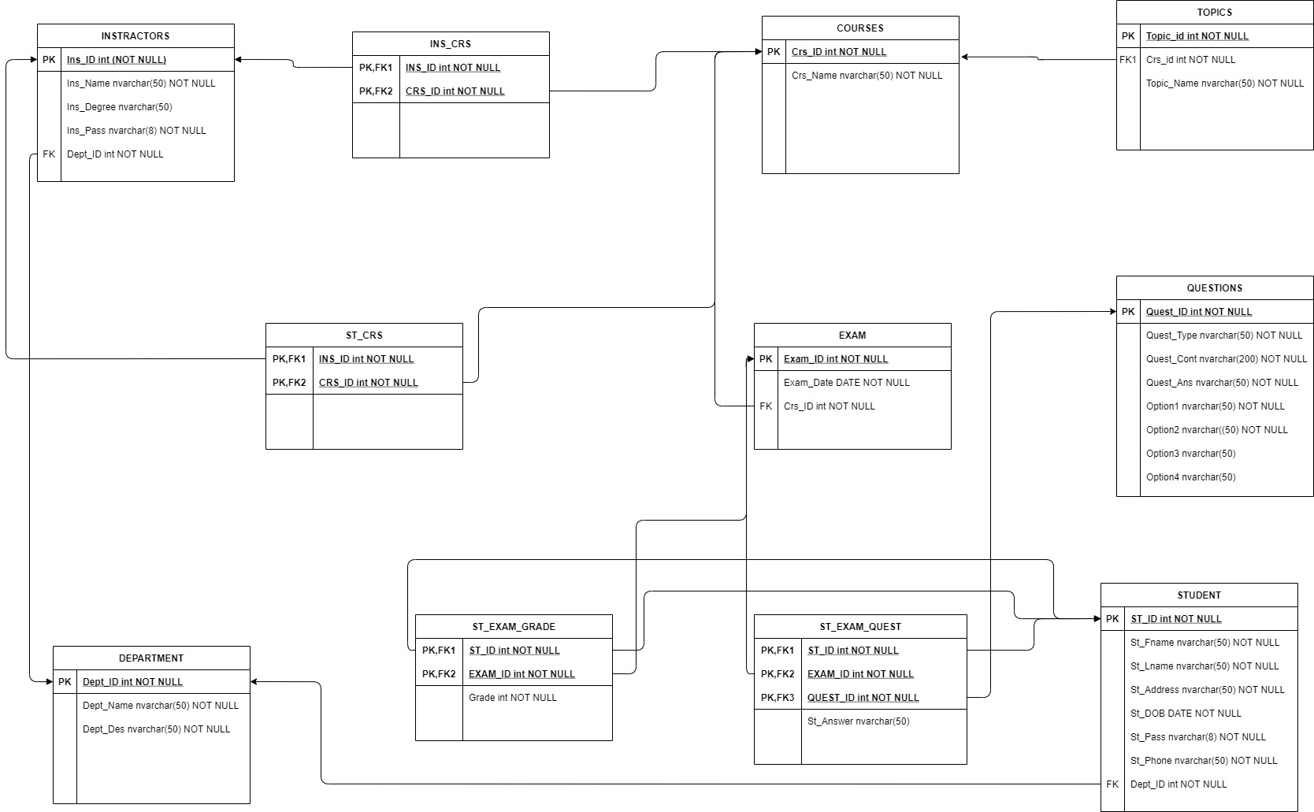
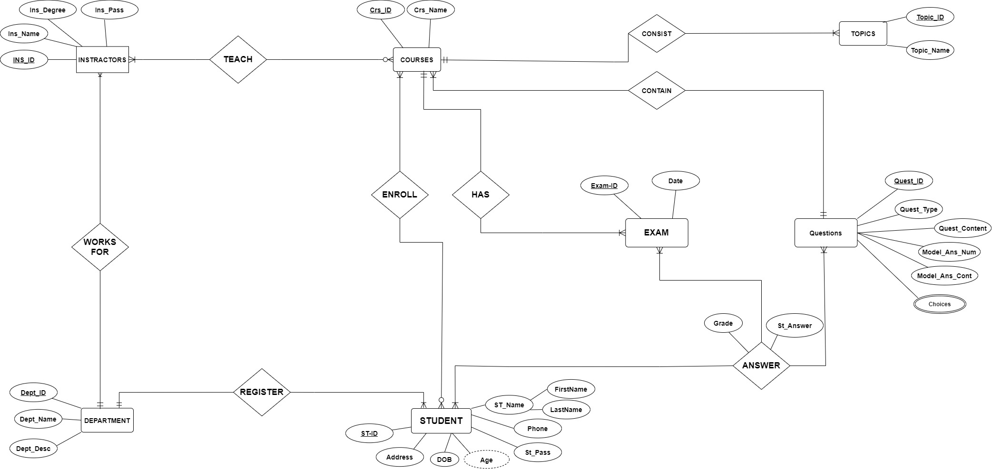
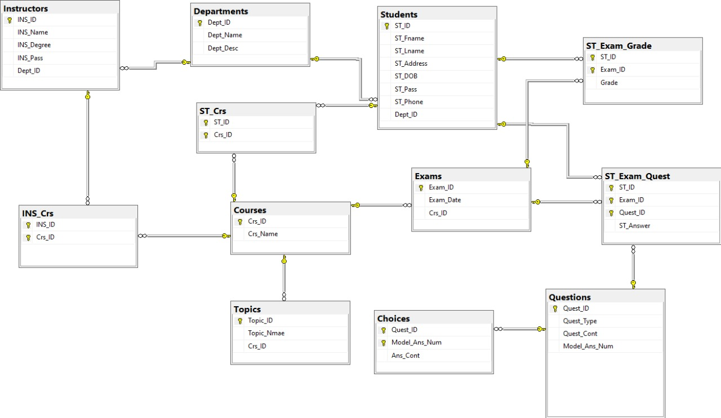
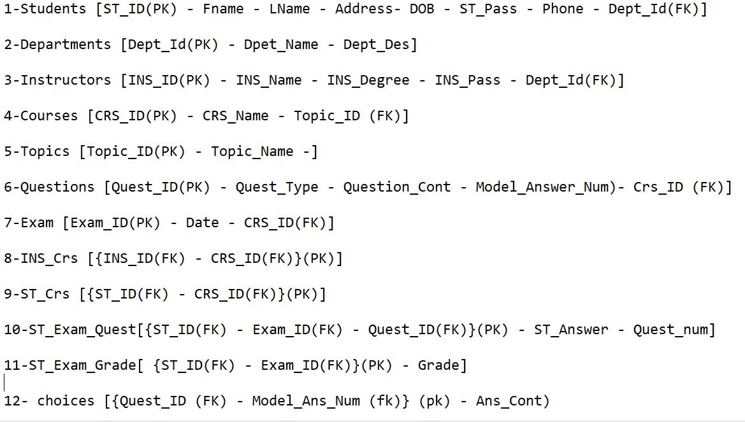
ERD & Mapping overview
Third
First
We’ve Implemented the relations between tables so we can get by easy join query, the needed data from DB.
We have created our Examination System ERD Diagram Model after many scenarios.
Fourth
Second
A LIVE model of Examination System Data Base has been created based on the previously steps..
We've Implemented the relationships among the entities, by ensuring that the primary key in one table also exists as an attribute in every table

Slide 8
ERD MODEL
- First, We’ve Suggested many Business logics and Diagrams that fits the project needs.
- Second, We’ve agreed to one of team proposals and get started..
#1
- Third, We’ve created the components and features of the ERD, till we have reached to the final model.
NOTE: The ERD was designed by Drawing tools.

Slide 9
Mapping overview
- First, We have Created a separate relational table for each entity, and Determined the primary key for each of the relations.
- Second, We've Implemented the relationships among the entities, by ensuring that the primary key in one table also exists as an attribute in every table (entity).
#2
NOTE: The Mapping was by a simple Note bad to write down our Mapping Scenarios .

Slide 10
Relational Tables
NOTE: The Relational tables were designed by drawing tools.
- First, We’ve translated our ERD & Mapping to Tables.
- Second, we’ve assigned the unique and foreign keys of the tables and it’s constraints.
#3
Third, We've made it a relational tables by linking and creating relations between common tables, this enables us to retrieve the data in one or more tables.

Slide 11
EXAMINATION SYSTEM DB/One More Step..
LIVE ‘Relational Data Base’
A LIVE model of Examination System Data Base has been created based on the previously steps..
NOTE: Database Diagram by SQL Server.

Slide 12

02.
SQL & SP
Using SQL, Creating Stored Procedures

Slide 13
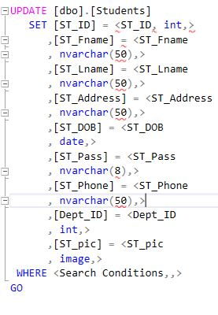
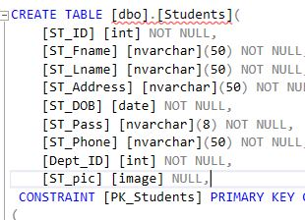
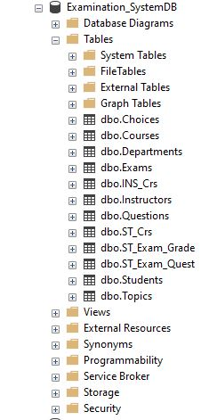


SQL SERVER CAN
HANDLE IT ALL!!
Using DML Commands for
Different purposes.
Using DDL Commands for
Different purposes.
Using SQL to Create &
Restore DB

Slide 14

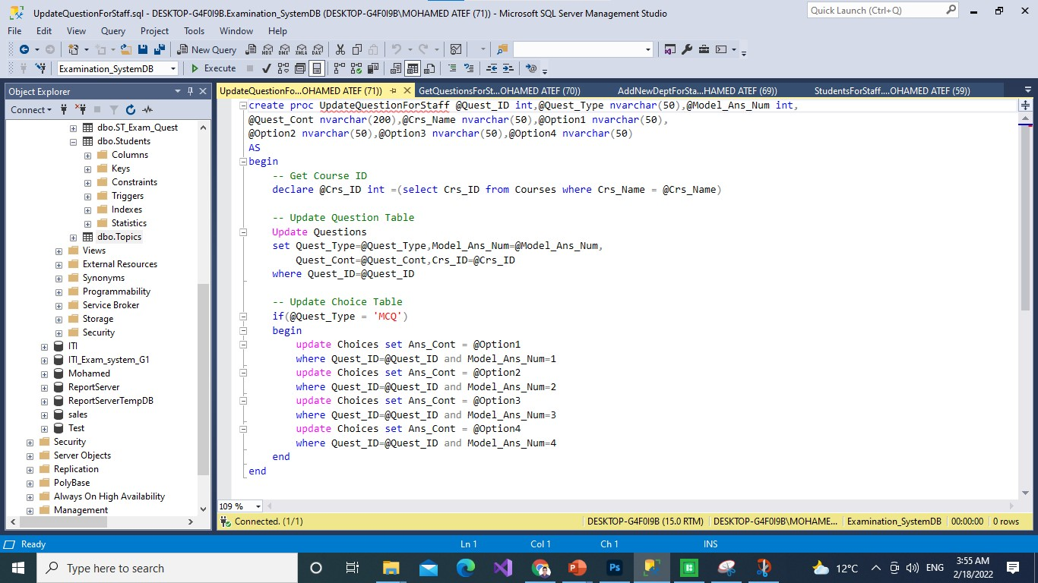
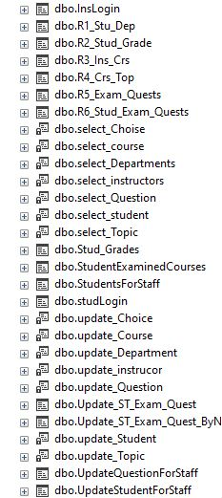
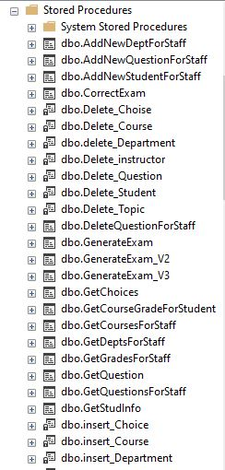
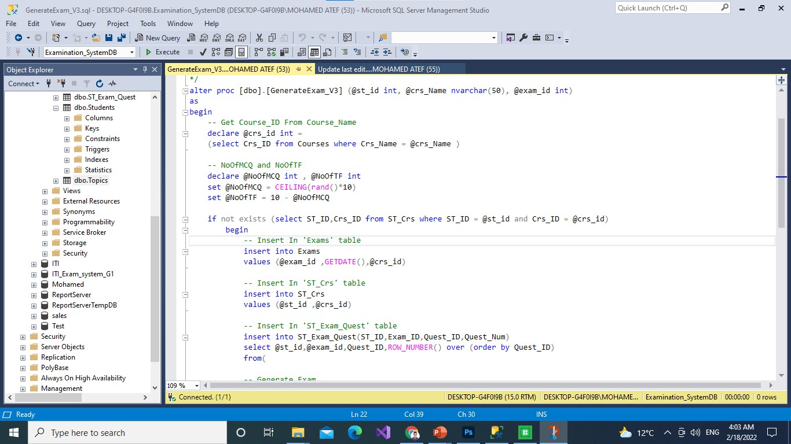
DOZENS OF STORED PROCEDURE FOR EVERYTHING!!

Slide 15
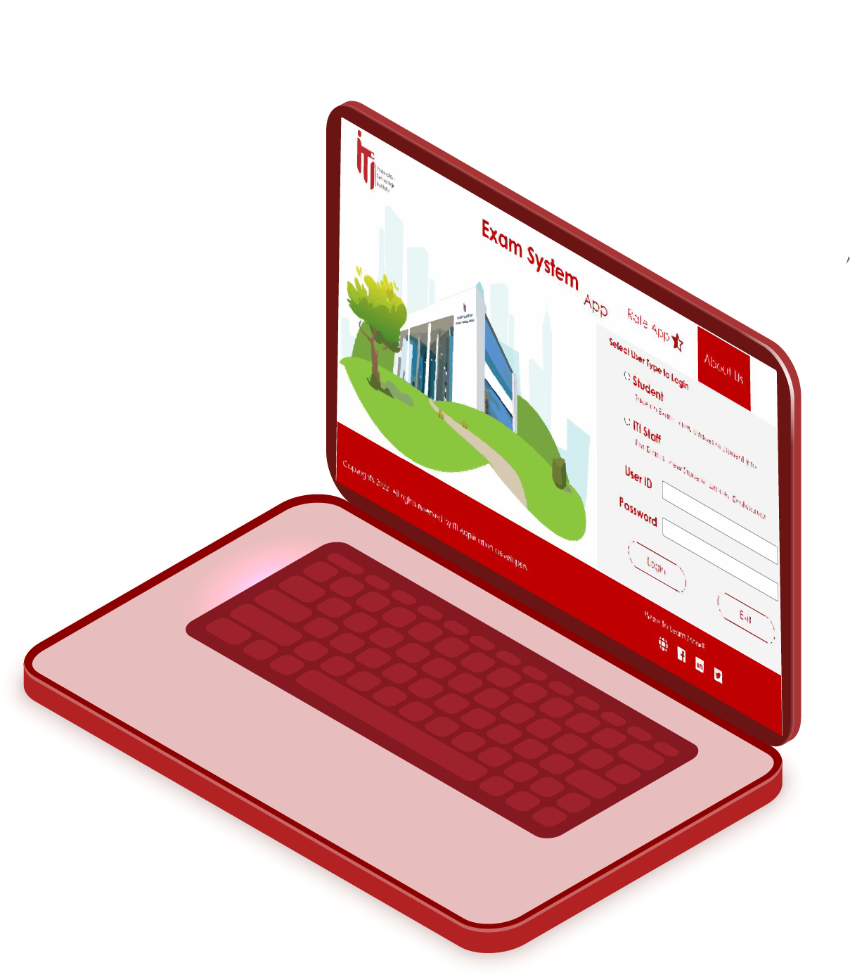
03.
Desktop App
Building an Examination System Application

Slide 16
Desktop Login Interface
SMOOTH USER LOGIN INTERFACE DESIGN WITH MULTIPLE OPTIONS FOR A GOOD EXPERIENCE!!
- Students and staff same login interface.
Flat buttons runs smoothly..
login with a smooth experience.
Connect to Social Media websites Directly!
About us button.
Comfortable Colors quoted from ITI Business Trade Mark.

Slide 17
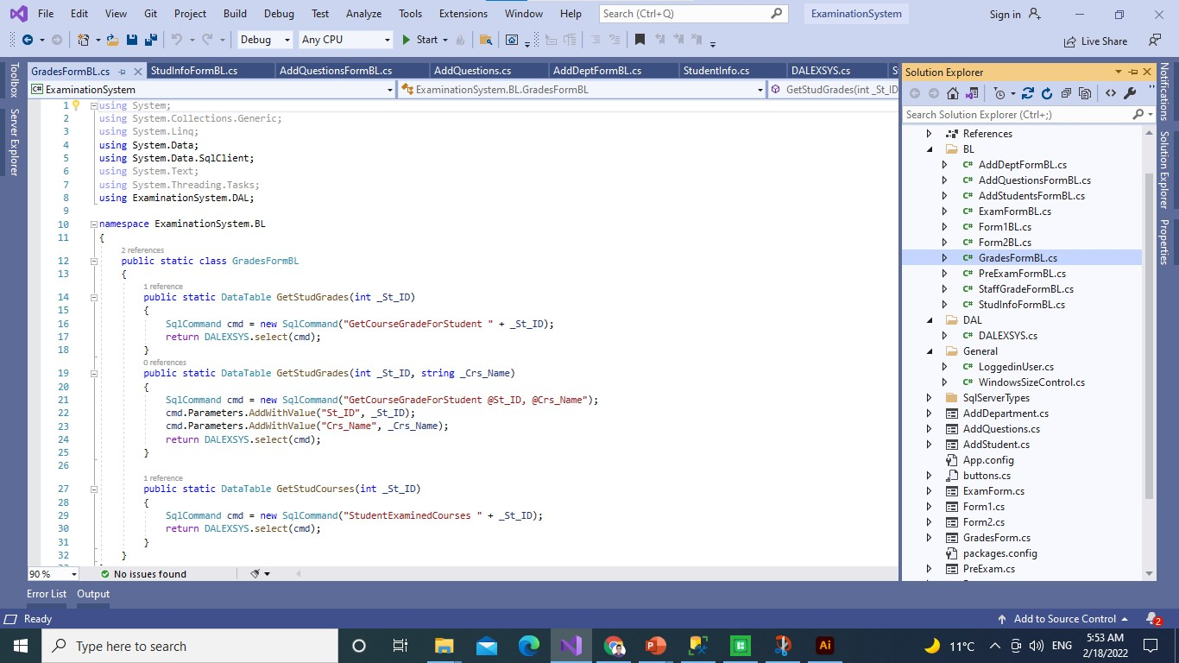
Desktop App Backend
ORGANIZED BACKEND FOR EASY ACCESS WITH BUSSINES LAYERS TO NOT REPEAT CODE.
- Connect to Data Base easily.
Run another data Source with just changing only the connection string.
Organized Code.

Slide 18
Stored Procedures for Everything
There are more than 15 Stored to link between the App and the Database.
There are about 48 Stored procedure created on Database.
15
48
There are 6 Stored Procedures for SSRS reports.
70
6
With almost total 70 Stored Procedure in our Project,
That’s a Big Number!!!

Slide 19
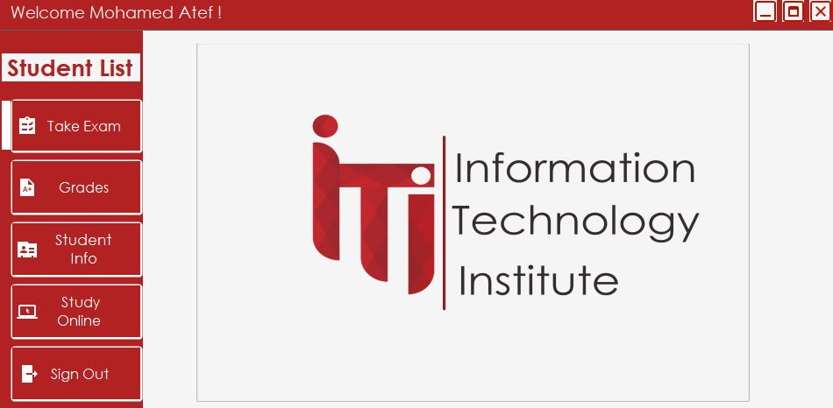
Desktop App Home Page
WELL DESIGNED HOME PAGE WITH AN INFOGRAPHIC SIDE PANEL FOR BETTER EXPERIENCE!!
- A down bottom label with a details about each button when you hover!
Image Change for a good looking!
Label to welcome every user on the above panel.

Slide 20
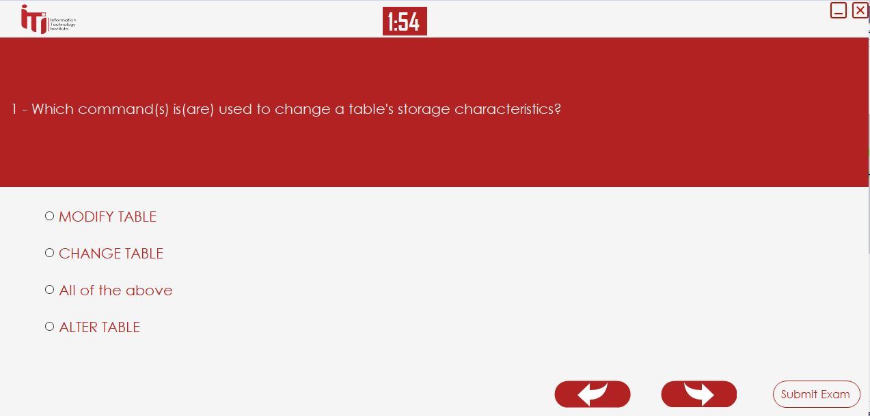
Take Exam and Get Started
TAKING AN EXAM IS NOT HARD ANYMORE!!
- The simplest desktop App for taking exam.
Select your course, then start an exam!
Timer with the exam for a real Experience.
Back & Forward to check your Answers!

Slide 21
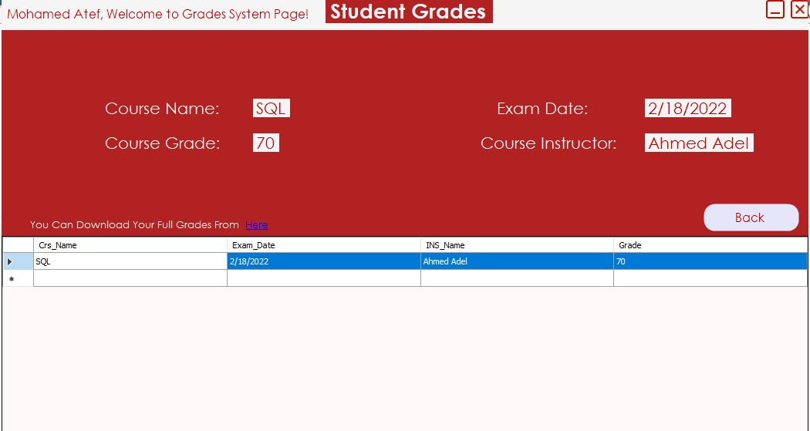
View your Courses Grades
DON’T WAIT FOR YOUR RESULTS, VIEW IT NOW!!
- View all of student grades with a click of button.
More information about the course, not only just grades!
Download your full grades in a designed report in all formats.

Slide 22
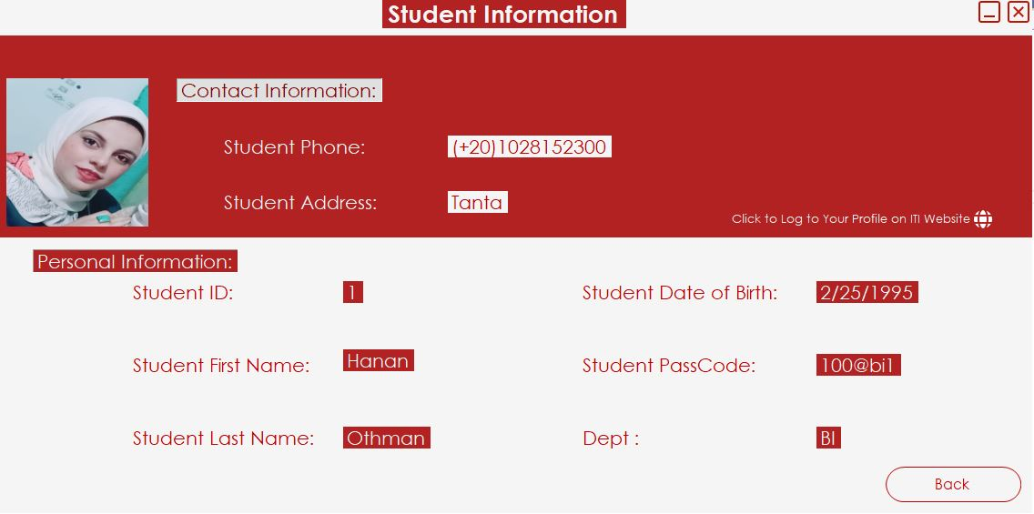
WE’VE ADDED A STUDENT PROFILE PICTURE FOR A UI EXPERIENCE
STUDENT PROFILE INFO
- View your Student profile information.
Student’s can not edit their data or update it.
New feature like Student profile pic.

Slide 23
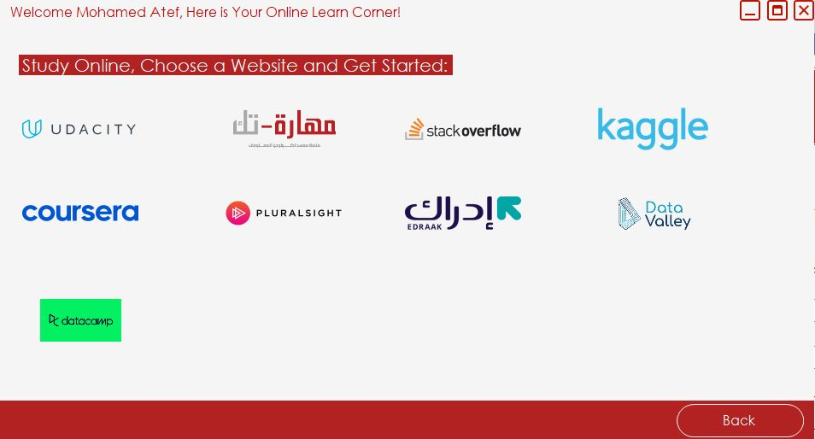
ONLINE COURSES
ONLINE WEBSITES FOR EDUCATIONAL PURPOSES TO INCREASE STUDENT KNOWLEDGE

Slide 24
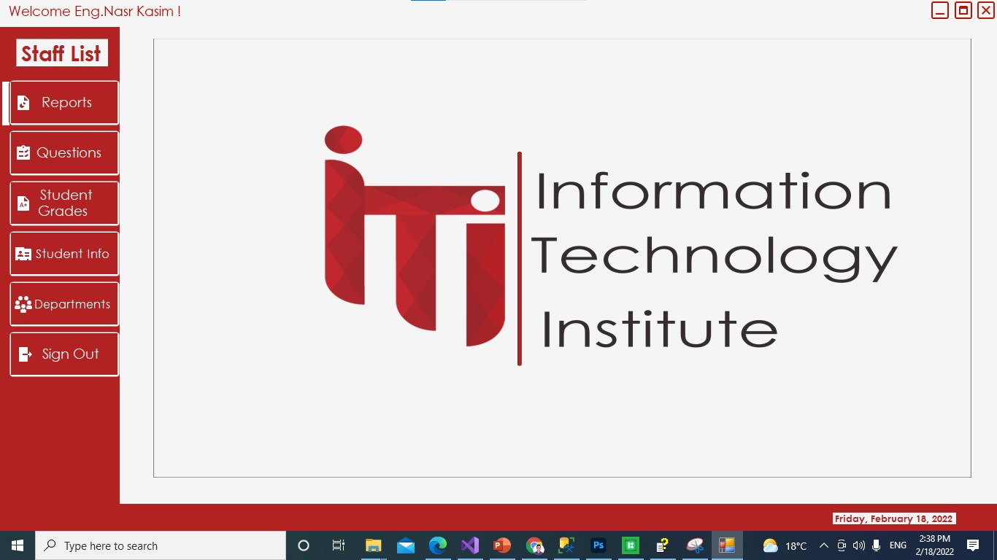
STAFF HOME PAGE
NEW APP HOME PAGE FOR ITI STAFF
WITH AN AWESOME CONTROL FEATURES!!
- Information at the bottom before you click with an Infographic photo for a better home page.
Many buttons to control mostly everything in the app.
Our Usual side panel with different flat buttons..

Slide 25
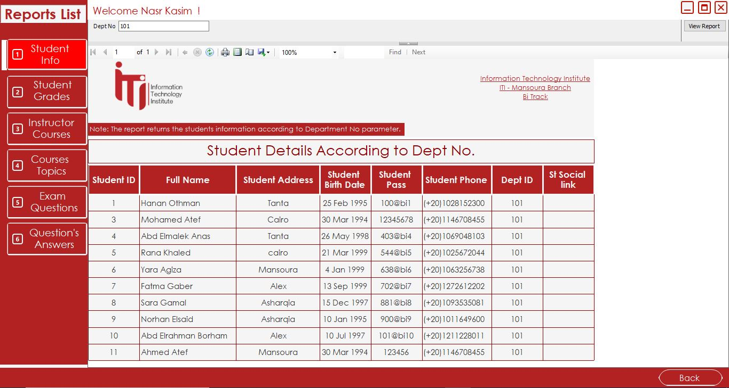
REPORTS PAGE
ALL REPORTS IN ONE PLACE
- You don’t have to open your local host anymore and wait for it to download, You can view it directly from your staff account, reports page.
NOTE: The ERD was designed by Drawing tools.

Slide 26
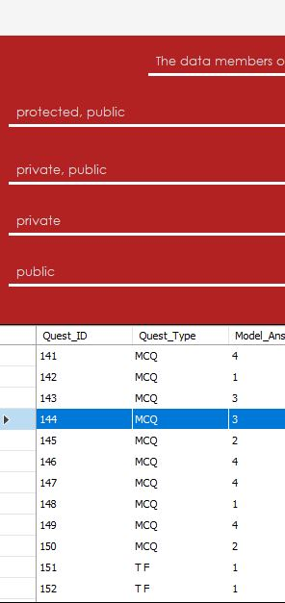
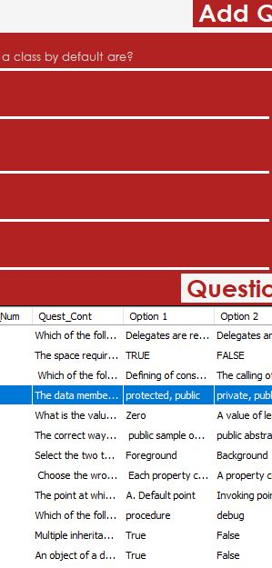
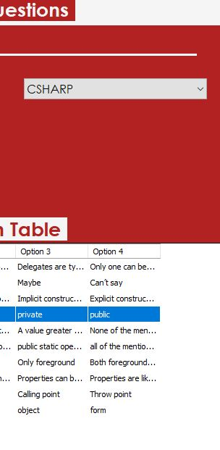
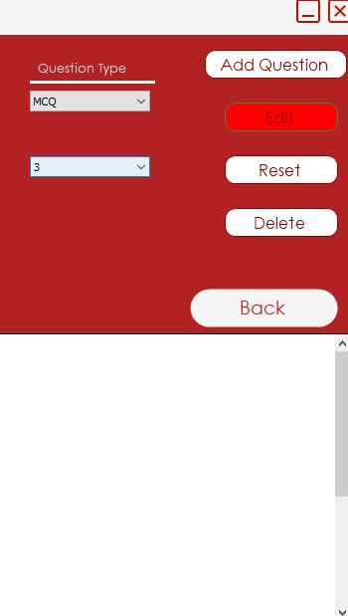
EDIT QUESTIONS
STAFF CAN
EDIT, UPDATE, DELETE Questions
Now, in Questions page, ITI Staff can Edit, Update, Delete Questions for their courses only!

Slide 27
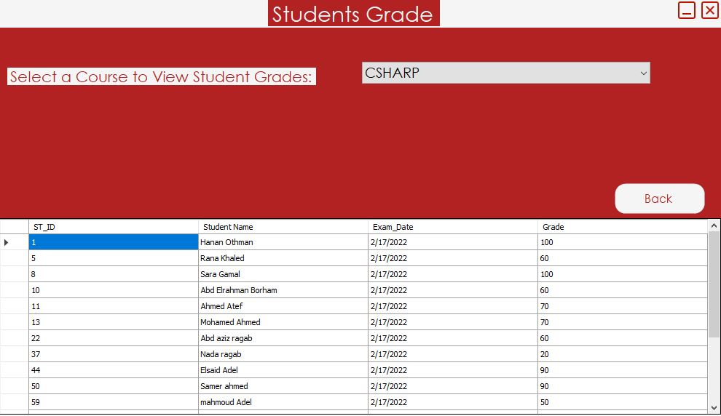
STUDENT GRADES HOME PAGE
SELECT A COURSE YOU TEACH AND GET YOUR STUDENT RESULTS AT THE EXACT TIME

Slide 28
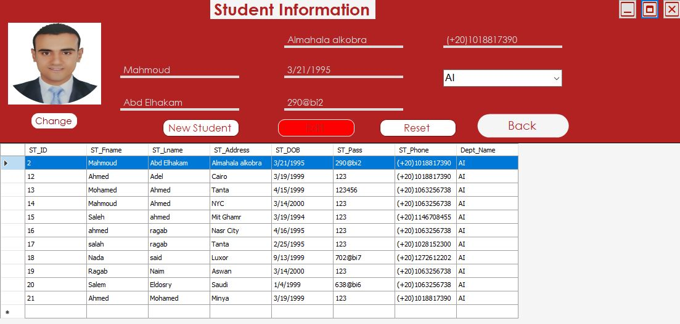
STUDENT CONTROL PAGE
INSERT, UPDATE, AND RESET STUDENTS IN SIMPLE CLICKS
Now, You don’t have to log into Database to add or update or edit students!
ITI STAFF USER, has permissions to edit, update, add students in the app.
Also add student profile pics or change it!

Slide 29
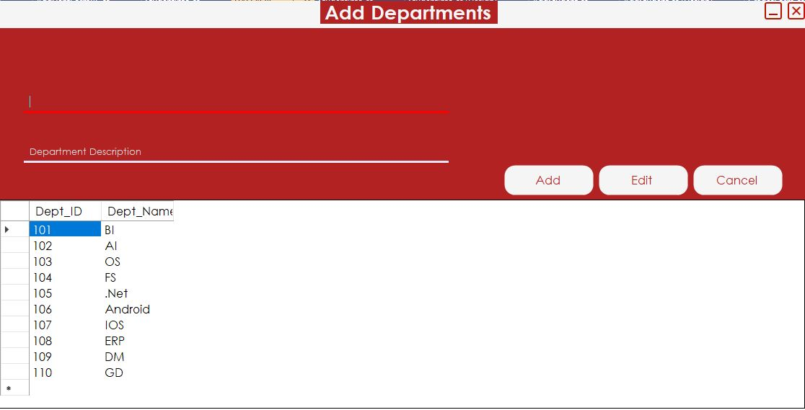
STUDENT CONTROL PAGE
ADD OR EDIT DEPARTMENTS
ITI STAFF USER, has permissions to add or edit a departments instead of logging inside database to run a query!

Slide 30

05.
SSRS
Creating Reports using SSRS tool in Visual Studio

Slide 31

SSRS
Report 1
Report 4
Report that returns the students information according to Department No parameter.
Report that takes course ID and returns its topics
Report 2
Report 5
Report that takes the student ID and returns the grades of the student in all courses.
Report that takes exam number and returns the Questions in it
Report 6
Report 3
Report that takes exam number and the student ID then returns the Questions in this exam with the student answers.
Report that takes the instructor ID and returns the name of the courses that he teaches and the number of student per course.

Slide 32

06.
POWER BI
Using Microsoft Power BI to build Dashboards

Slide 33
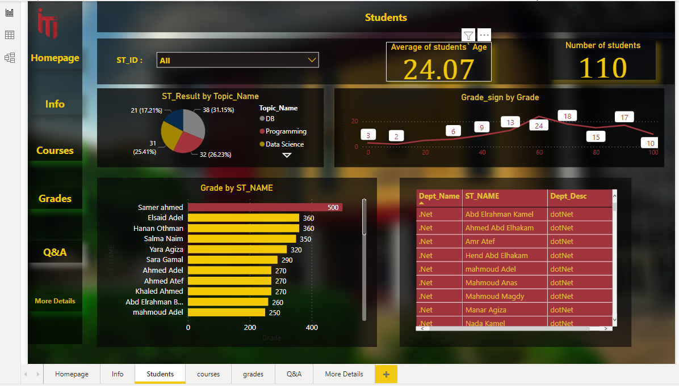
POWER BI
POWER BI TOOL TO VIEW THE DASHBOARDS & INSIGHTS

Slide 34
Thank you!
We’ve reached the end of the presentation.

